Slide 1
Improper Payments Initiative
Why this is a key priority for VA?
Reducing improper payments is VA’s #1 financial management priority
The President and the Office of Management and Budget (OMB) have made eliminating waste, fraud, and abuse in Federal programs, including reducing and recapturing erroneous payments, one of its top financial goals.
2012 PAR showed a slight reduction in reported improper payments -$2.2 billion for 2011 versus $2.4 billion in 2010.
In March 2013, the Inspector General found that VA for a second consecutive year has not complied with the provisions of IPERA. The IG found the following non-compliance issues:
VHA Non-VA Care Fee program improper payment rate exceeded 10% and the associated reduction target was not achieved
VBA pension reduction targets could not be verified due to a change in reporting methodology
VHA and VBA statistical estimation methodologies need improvement
VBA did not report recoveries related to recapture audit activity
VA was late in providing two reports to Congress and OMB
Goals to be accomplished
Reduce the number and value of improper payments made by VA.
Improve improper payment identification and reporting processes.
Comply with the provisions of IPERA.

Slide 2
Commercial Small Business Payments
Note: OMB instructed Agencies to accelerate payments to small businesses with the goal of paying small businesses within 15 days of receipt of appropriate documentation. Delivery of goods and acceptance of services must still occur before making payment. VA has for many years used existing authority in the Prompt Payment Act to accelerate commercial vendor small business payments after receiving all proper documentation, including acceptance. Entities designated as small businesses are submitted for payment through FMS (not money managed) when acceptance occurs.
March Highlights:
VA paid 94 percent of small business invoices in March (FYTD 94 percent) within the 15 day timeliness metric bettering the VA goal
Station 791 (Denver Acquisition and Logistics Center) continues a new high volume small business contract for the repair of hearing aids paid within the 15 day timeliness metric which has helped boost payment timeliness
FSC issued a notice to VA stations highlighting the OMB goal and encouraged timely certification of invoices and receipt processing during VHA Fiscal Officers Calls
FSC used mail campaigns to vendors to promote ways to shorten the payment cycle time and obtain payment information by using Electronic Funds Transfer (EFT), Electronic Invoicing, Central Contractor Registration (CCR), and FSC’s Vendor Inquiry System (VIS) web portal to monitor payment information
FSC continues to analyze small business payment data to identify opportunities to further increase payment timeliness and will work with Administrations/Stations to identify causes for delayed payments and potential procedures for accelerating payments
Prepared by: Kevin Miers, Systems & Procedures Analyst, VA Financial Services Center, Kevin.Miers@va.gov
Approved by: Robert Adams, Deputy Director, VA Financial Services Center, (512) 460-5002
Version Date: April 8, 2013

Slide 3
Metric:
Linkages
Org | OM (Finance)
B/Line | Enabling
B/Scorecard | Operations
Strategic Goal | 4
Corp Outcome | Improve Management and Support Services Timeliness and Quality
Status
Current Month (Mar)
Next Month (Apr)
Projected Green Date | N/A
Monthly Actual | 94%
FYTD Actual | 94%
Commercial Small Business Payment Timeliness
G
G
Metric ID | OM (Finance)-197
Timeliness Exceeds Goal
↑
Desired
Direction
Percent Paid Within 15 Days of Receipt of Proper Payment Documentation
↓
Desired
Direction
Trend
Variance Thresholds
Red | ≤ -10%
Yellow | ≤ -5%
Green | > -5%
Notes:
Metric Format - Percentage

Slide 4
Overall Commercial Vendor Payment Timeliness
Note: Overall Commercial Vendor Payment Timeliness measures VA vendor payment timeliness against the July 2012 OMB guidance to pay all commercial vendors within 15 days of receipt of all payment documentation. Delivery of goods and acceptance of services must still occur before making payment.
March Highlights:
In August 2012, VA established a new Prompt Payment Type Code (“Y”) to facilitate acceleration of commercial vendor payments to pay at 14 days after receipt of all proper payment documentation
FSC worked with the Denver Acquisition and Logistics Center (DALC) to program the use of the new Prompt Payment Type “Y” code to pay their EDI prosthetics payments
During March, VA paid 84 percent (FYTD 85 percent) of all commercial vendors within the 15 day OMB goal
Payment timeliness declined from 89 percent in February due to delayed certification of invoices and receiver processing
FSC paid 88 percent of March’s payments within the 15 day OMB goal
Non-FSC entities paid 82 percent of all commercial vendors within the 15 day OMB goal
Prepared by: Kevin Miers, Systems & Procedures Analyst, VA Financial Services Center, Kevin.Miers@va.gov
Approved by: Robert Adams, Deputy Director, VA Financial Services Center, (512) 460-5002
Version Date: April 8, 2013

Slide 5
Metric:
Linkages
Org | OM (Finance)
B/Line | Enabling
B/Scorecard | Operations
Strategic Goal | 4
Corp Outcome | Improve Management and Support Services Timeliness and Quality
Status
Current Month (Mar)
Next Month (Apr)
Projected Green Date | N/A
Monthly Actual | 84%
FYTD Actual | 85%
G
G
Overall Commercial Vendor Payment Timeliness
G
Metric ID | OM (Finance)-198
Timeliness Above Goal
↑
Desired
Direction
Percent Paid Within 15 Days of Receipt of Proper Payment Documentation
↓
Desired
Direction
Trend
Variance Thresholds
Red | ≤ -10%
Yellow | ≤ -5%
Green | > -5%
Notes:
Metric Format - Percentage

Slide 6
Undelivered Orders (UDOs)
Note: OMB Circular A-123, Management Responsibility for Internal Controls, requires that management be responsible for establishing and maintaining internal controls to achieve the objectives of effective and efficient operations, reliable financial reporting, and compliance with applicable laws and regulations. To ensure compliance with the above circular and Generally Accepted Accounting Principles (GAAP), VA Financial Policies and Procedures Manual, Volume II, Chapter 5, Section 050204 requires monthly reviews and reconciliations be performed to ensure that open obligations, including undelivered orders (UDOs) and delivered unpaid obligations, are valid and appropriate and adjustments are made as necessary.
March Highlights:
OFPIAR analyzed VA-wide open obligations, established a baseline, and identified all UDOs that need to be reviewed for appropriate financial or administrative actions. The baseline, established September 30, 2012, totaled $1,086,569,995.
Office of Management issued a memorandum in December 2012 requiring Administration CFOs and Staff Offices to review open obligations comprised of contracts, travel, and other obligations, to determine obligations which should be closed or where the period of performance needed to be modified. A detailed list of each organization’s aged UDOs has been placed in VAIQ (# 7306399).
OFPIAR is tracking and monitoring Administration’s and Staff Office’s progress monthly. As of March 31, 2013, the UDO balance has been reduced to $469,567,484, a 57% reduction from the baseline. Therefore, the remaining balance is 43%, bringing VA close to the annual target of 40%.
Prepared by: Pushparajan Arokiaswamy, Office of Financial Process Improvement and Audit Readiness. Pushparjanan.Arokiaswamy@va.gov.
Approved by: Shirley Pratt, Associate Deputy Assistant Secretary, Office of Financial Process Improvement and Audit Readiness. Shirley.Pratt@va.gov
Version Date April 02, 2013

Slide 7
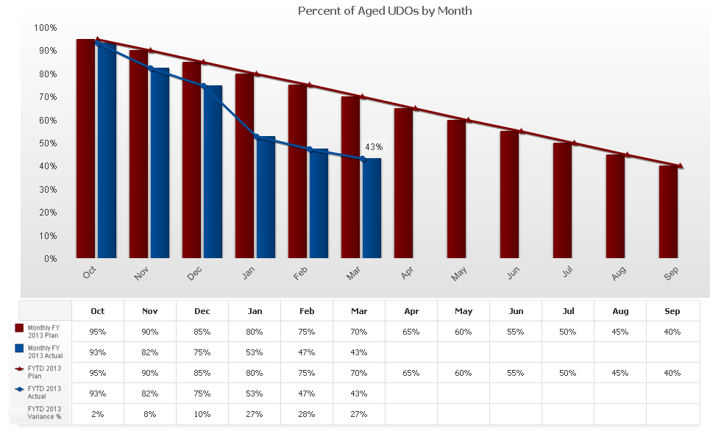

Metric:
Linkages
Org | OM (Finance)
B/Line | Enabling
B/Scorecard | Operations
Strategic Goal | 4
Corp Outcome | Improve Timeliness in Closeout of Aged Undelivered Orders
Status
Current Month (Mar)
Next Month (Apr)
Projected Green Date | N/A
Monthly Actual | 43%
FYTD Actual | 43%
Closeout of Aged Undelivered Orders
G
G
Metric ID | OM (Finance)-197
Closed Undelivered Orders Exceeds Target
↓
Desired
Direction
Desired
Direction
Variance Thresholds
Red | <-10%
Yellow | <-5%
Green | ≥-5%
Notes:
Metric Format - Percentage

Slide 8
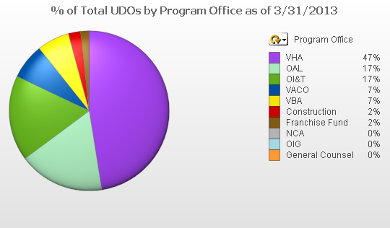
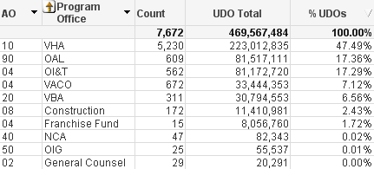
Status of Aged Undelivered Orders
Balance by Program Office as of March 31, 2013

Slide 9
Status of Aged Undelivered Orders
Balance by Program Office as of March 31, 2013
FYTD Reduction by Program Office
Monthly Balance Detail by Program Office

